Slide 1

SentimentAnalysis based on Random Forest Model
Nikhil Chezian

Slide 2
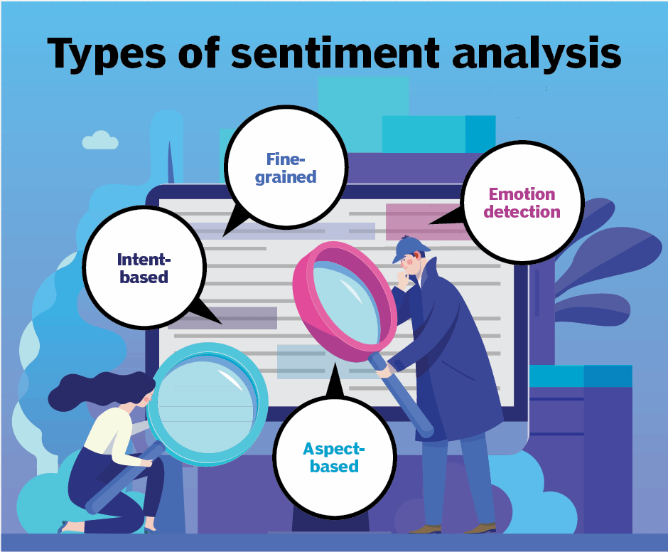
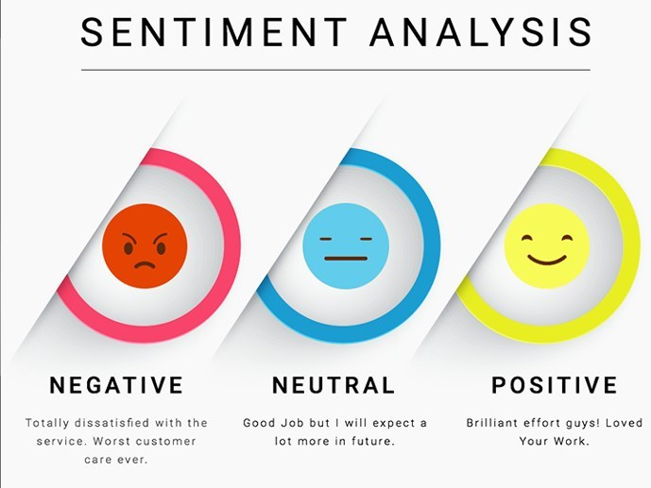
The WHAT ??

Slide 3
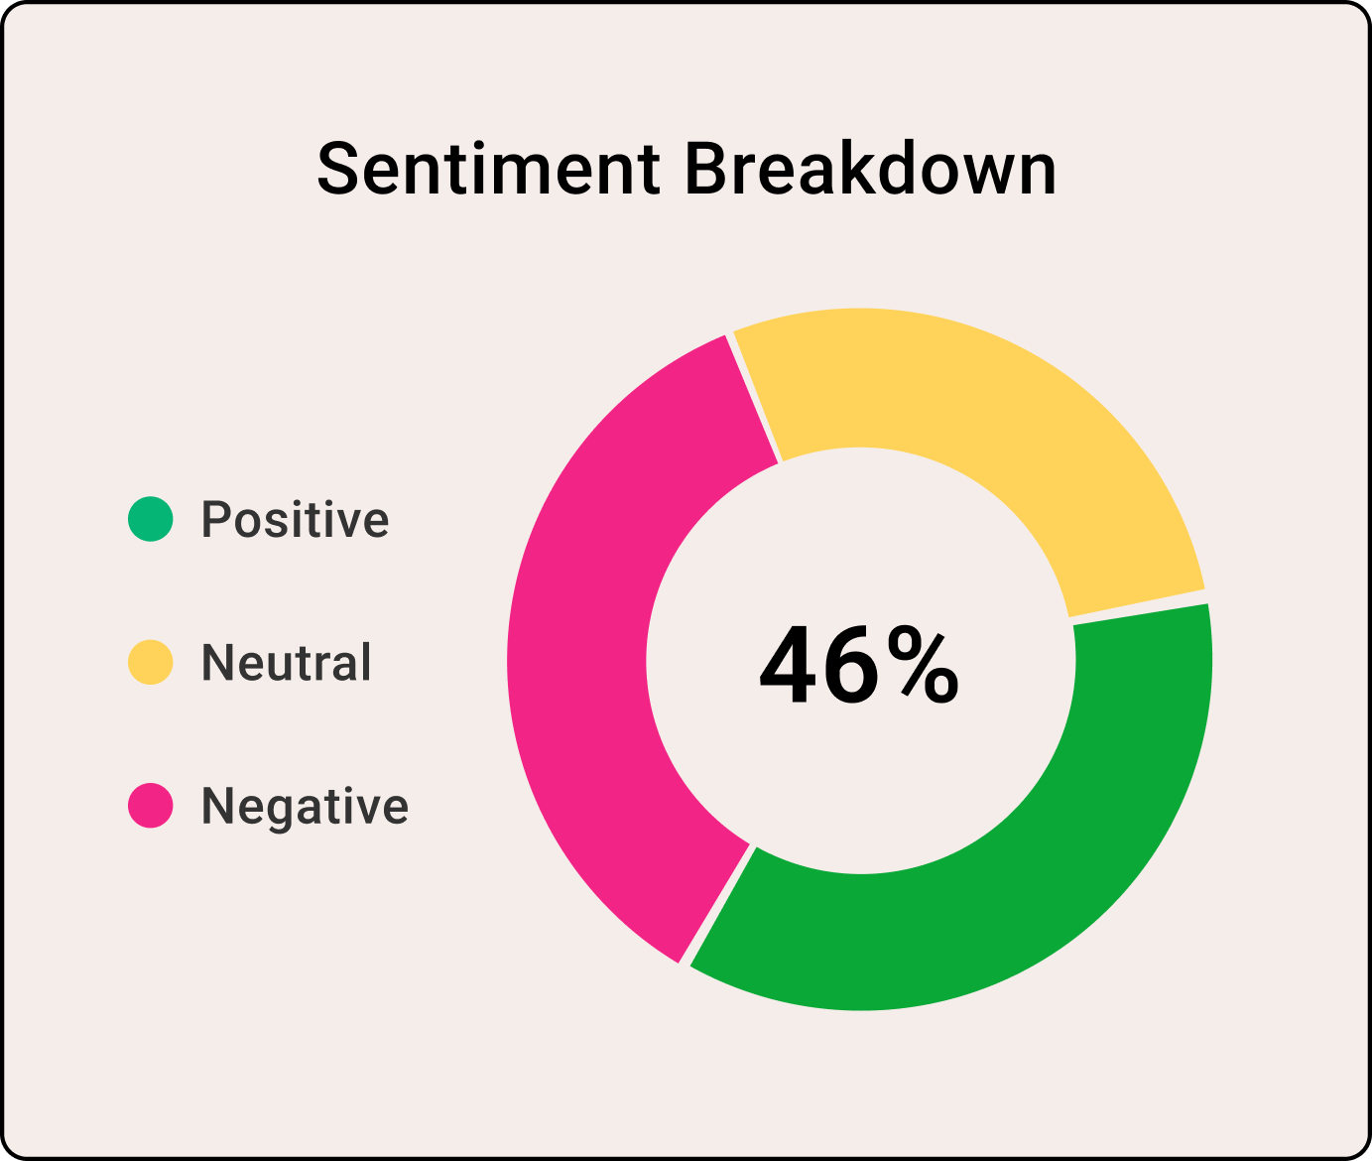
The WHY ??
Applications of Sentiment Analysis
Product Improvement
Competitive analysis
Political Analysis
Marketing Campaigns
Academic Research
Risk Management
Healthcare
Public Opinion Monitoring

Slide 4
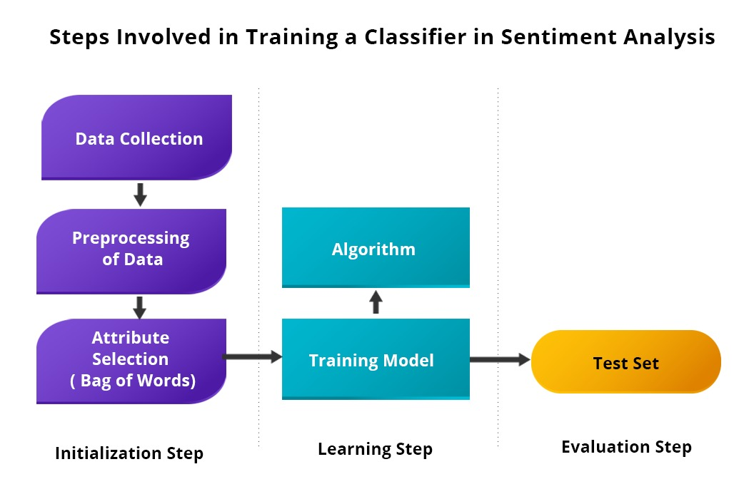
The HOW ??

Slide 5

Steps
Data Collection - Text data is gathered from various sources, such as social media, reviews, or surveys.
Data Preprocessing - Clean and prepare the data by removing noise, special characters, and irrelevant information.
Tokenization - Break down text into individual words or tokens.
Stopword Removal - Eliminate common words like "and," "the," and "is" to focus on meaningful content.
Text Normalization - Convert text to a consistent format, including lowercasing and lemmatization.
Feature Extraction - Transform text into numerical features, like word frequency or TF-IDF scores.

Slide 6

Steps
Model Selection - Choose an appropriate sentiment analysis model, such as machine learning or deep learning algorithms.
Training - Train the selected model on labeled data with sentiment annotations.
Testing and Validation - Evaluate the model's performance using a separate dataset to ensure accuracy.
Sentiment Prediction - Apply the trained model to new, unlabeled data to classify sentiments.
Results Interpretation - Analyze the sentiment predictions to gain insights into the data.
Visualization - Present the sentiment analysis results using visualizations like charts or graphs.

Slide 7


Random Forest
OR

Slide 8
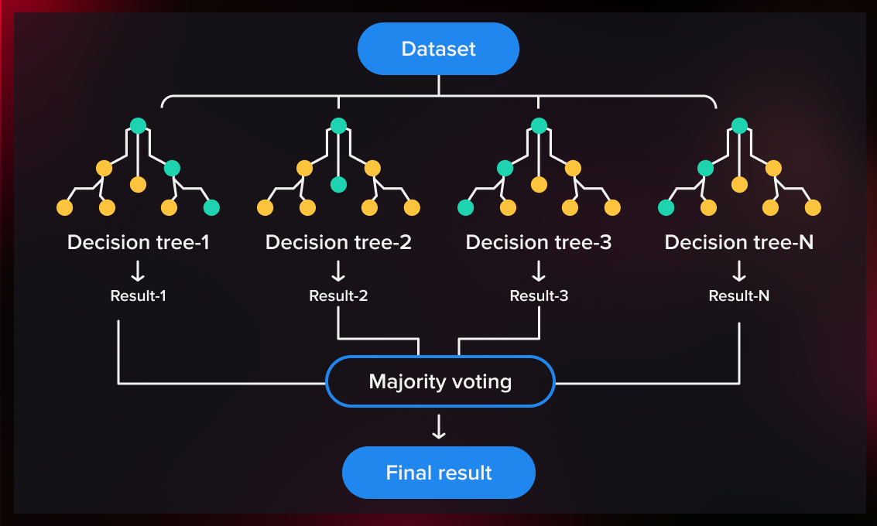
Haha, well, it is a classifier Model in Machine Learning

Slide 9
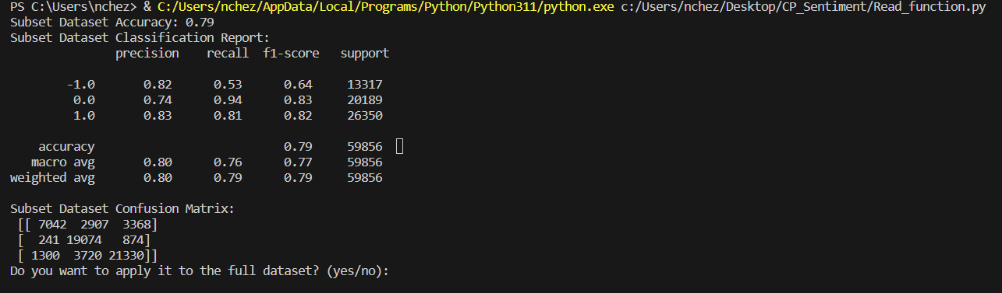
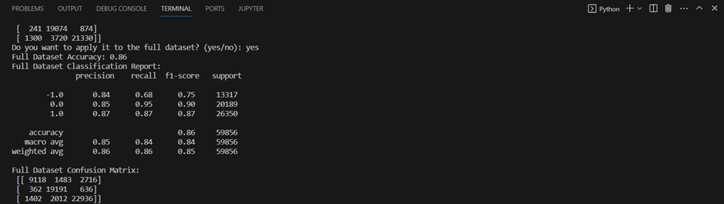
Output (Analysis)
Subset of the Dataset
Complete Dataset

Slide 10
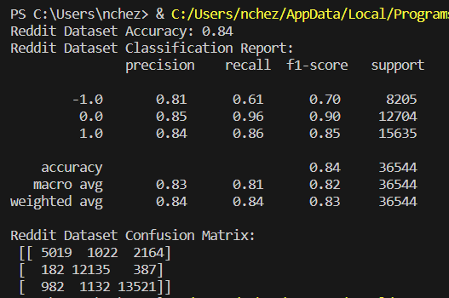
Output (Analysis)
The accuracy obtained when the model is applied on the whole set at once.
This can be attributed to the factors such as increased randomness of data, overfitting.

Slide 11


